Slide 1
Performing Style Transfer using GANs vs. CNNs
Manmeet Singh
Chinmay Vadgama
Aditya Wadnerkar

Slide 2
Project Overview
We performed a comparison between two style transfer techniques
CNNs
GANs
Custom Coded VGG19 using tensorflow 2.0
Re-wrote cycleGAN using Tensorflow 2
Trained models using custom desktop setup
Deployed the comparison models side-by-side in web app

Slide 3
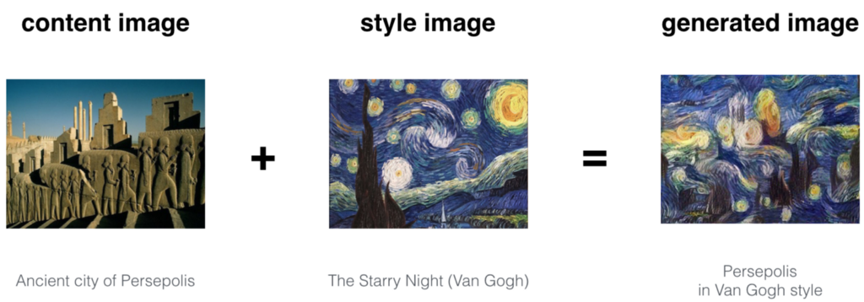
Neural Style Transfer
Problem Definition :
Neural style transfer is a technique where there are 3 images. Content image, Style image and input image. We want to retain content of the content image into our input image and we want to retain style of the style image into our input image.

Slide 4
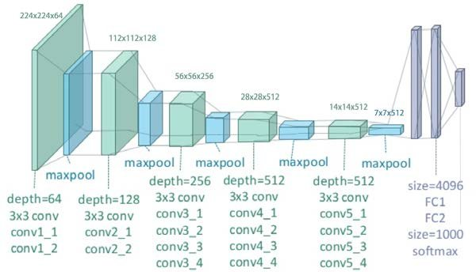
Style Transfer with VGG19 CNN
VGG19 Architecture
Content Loss and Style Loss

Slide 5
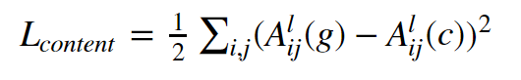
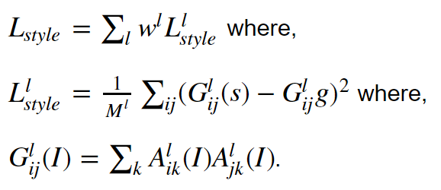
Content Loss and Style Loss
Content Loss:
Style Loss:

Slide 6
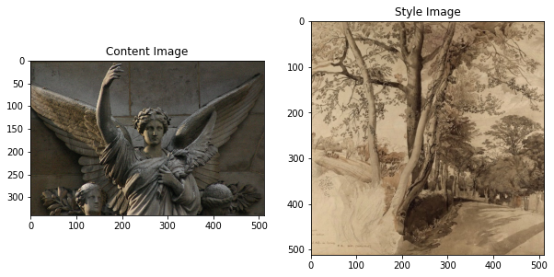
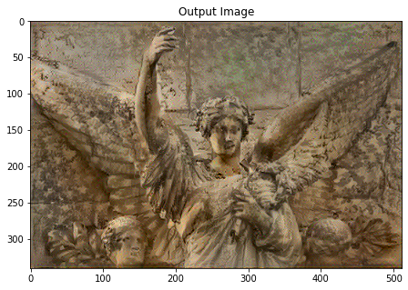
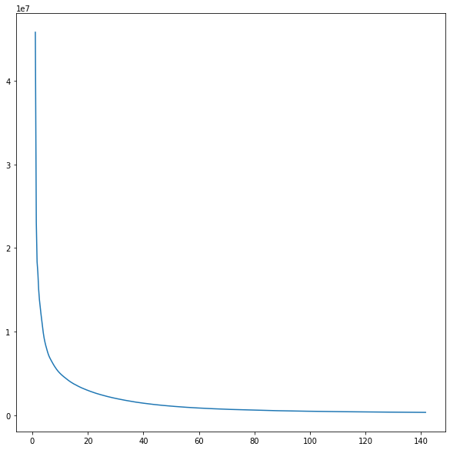
VGG19 loss convergence and output
500 Iterations
1 Style Transfer Learning
140 Seconds
Starts converging in 20-30 sec duration
Device : GTX GPU (Colab)

Slide 7
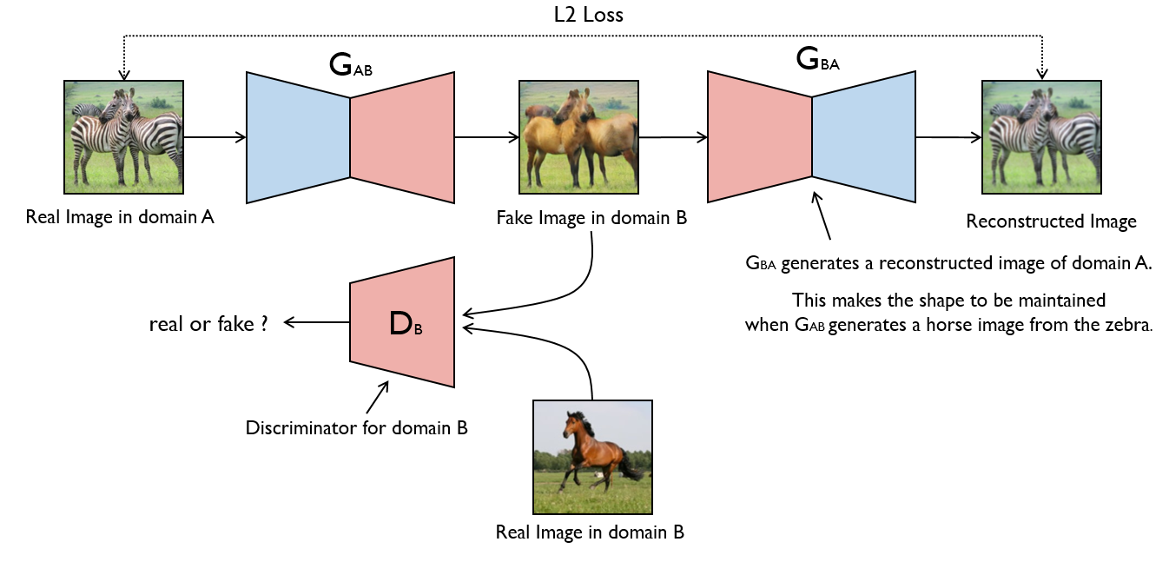
CycleGAN High Level
Basic goal is to take 2 datasets and learn the difference in their distributions
Objective functions:
Adversarial loss
Cycle consistency loss
Discriminators are PatchGANs
Look at surface level features of a small segment of image
Notes:
Adverserial loss is where both generators are trying to fool the discriminator in not being able to tell apart the real image from the fake. Use something like least square to capture this (doesn’t preserve identity)
Cycle consistency loss ensures you get back something similar to what you put in after doing a full cycle of translations (from A->B->)

Slide 8
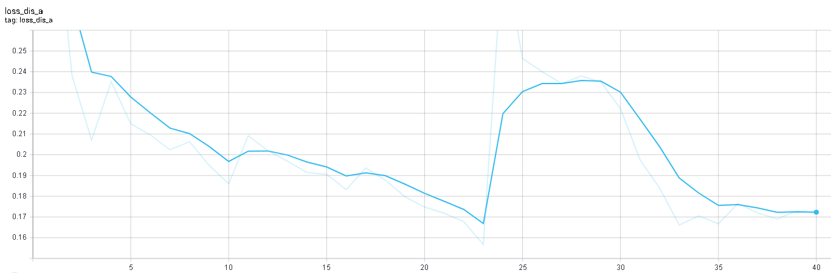
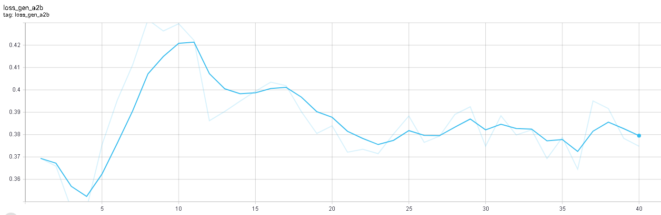
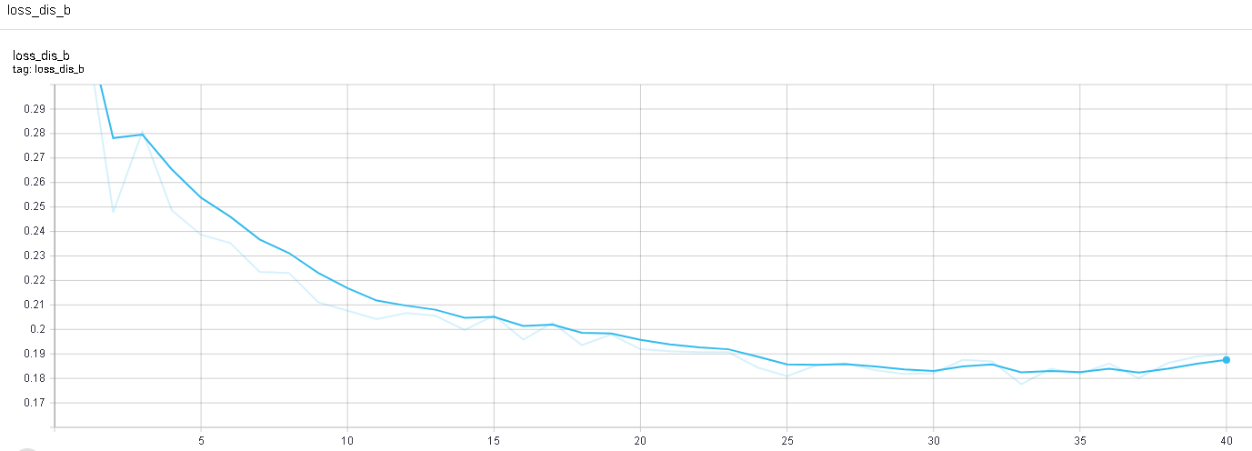
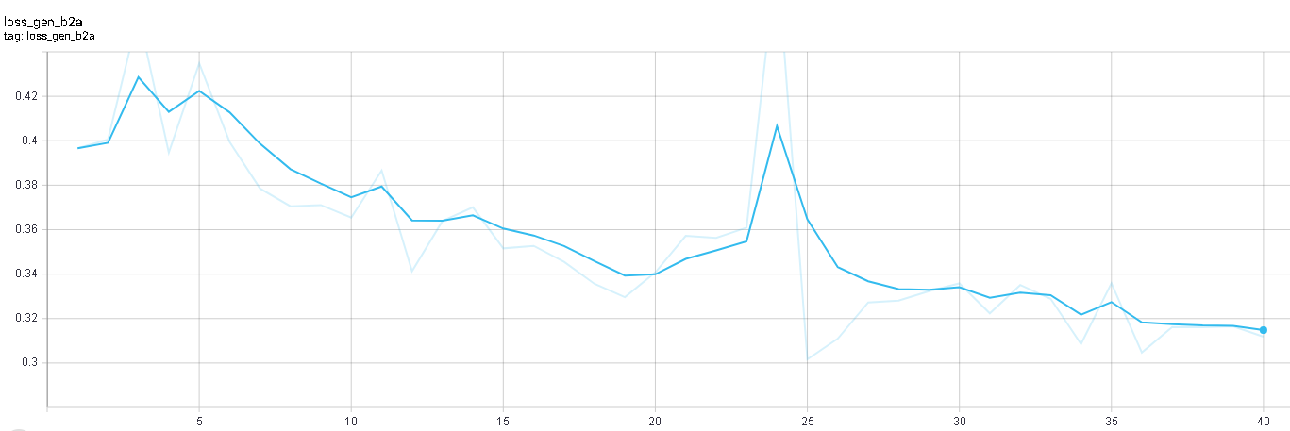
cycleGAN Metrics
Loss Discriminator A
Loss Generator A to B
Loss Discriminator B
Loss Generator B to A

Slide 9
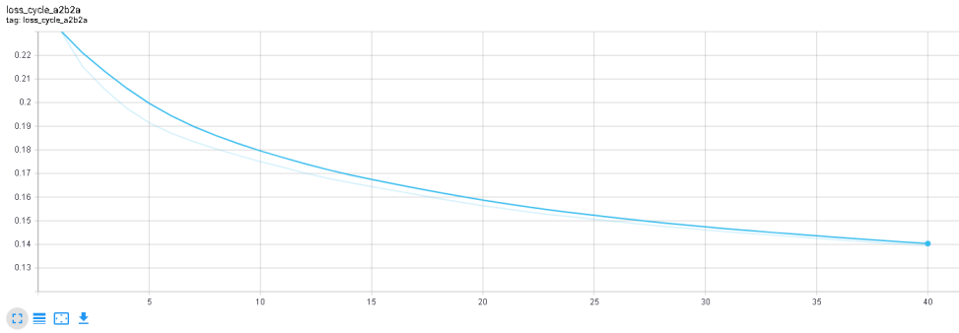
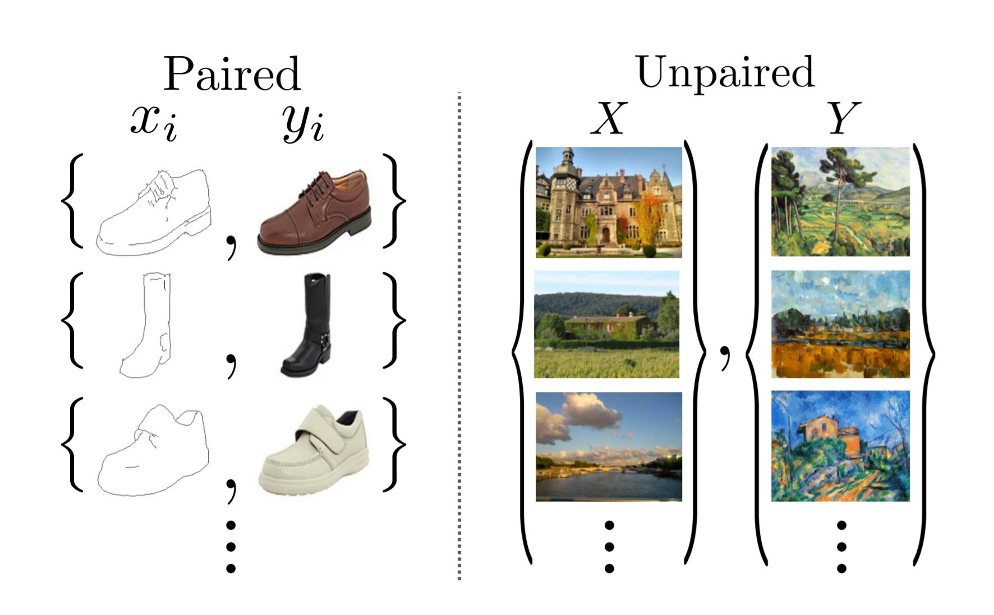
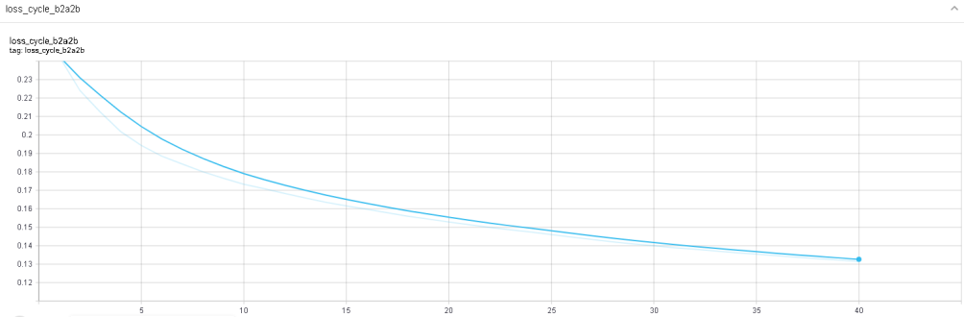
cycleGAN Cyclic Loss
Represents the encoder decoder to encoder process
Discriminator comes after the second step
This steps allows for unpaired learning
Loss Cycle A to B to A
Loss Cycle B to A to B

Slide 10
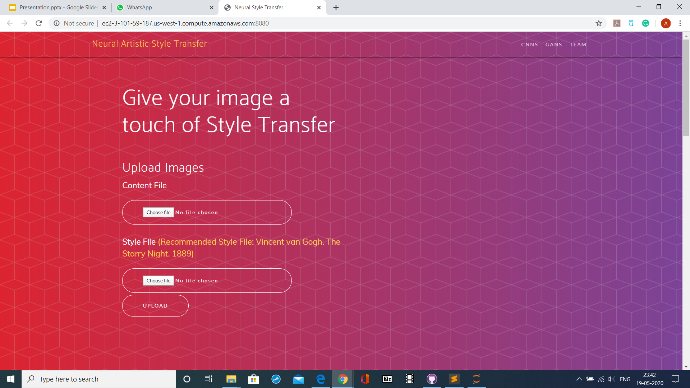
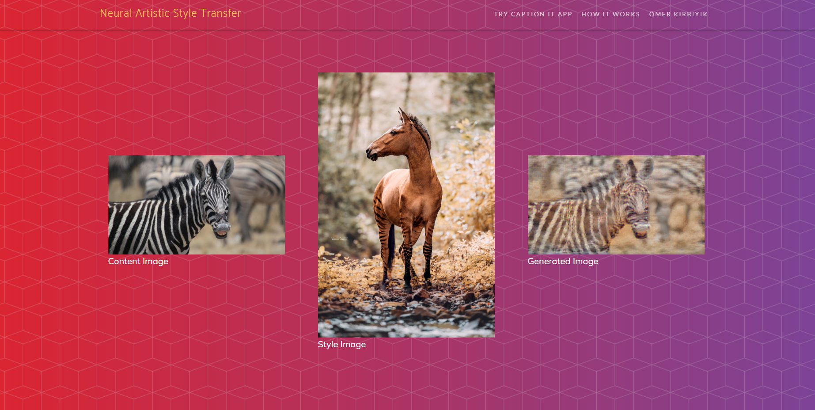
Deployment
Flask app
Hosted on AWS

Slide 11
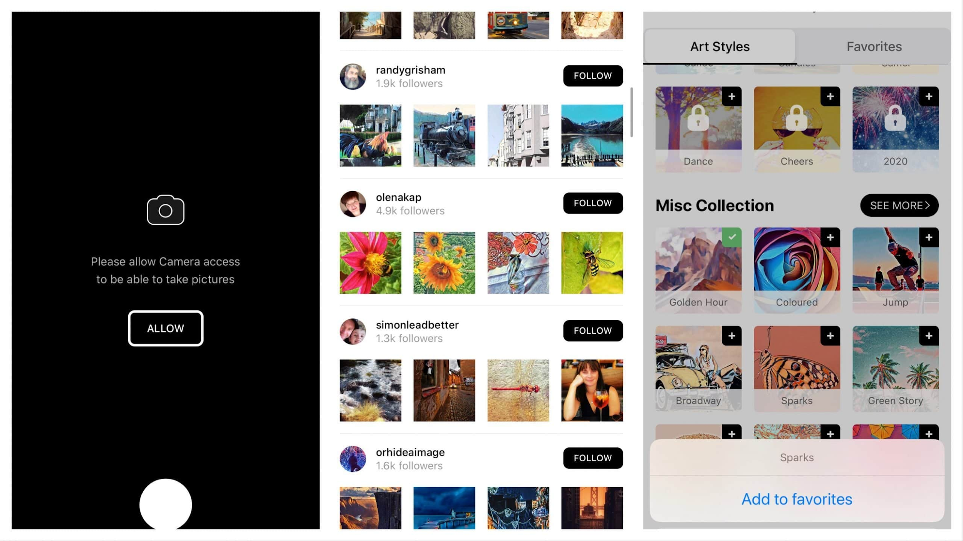
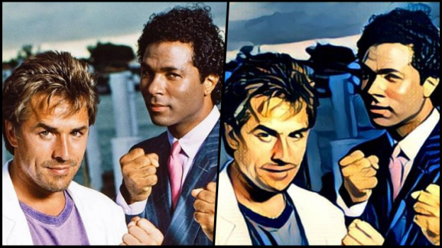
Applications
Filters for Photo Editing Apps

Slide 12
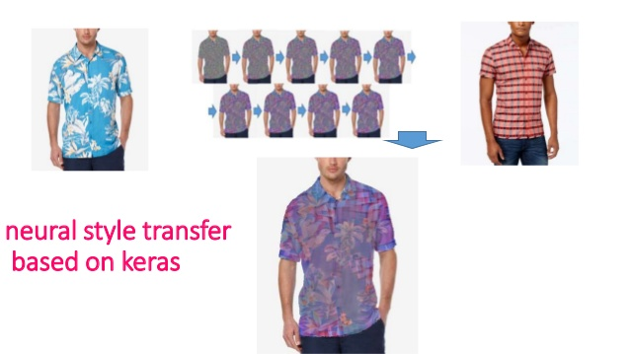
Applications
Virtual Dressing Room (Online Shopping)

Slide 13
Lessons Learned
Working with GANs and CNNs in Tensorflow
Gathering large amount of training data
Setting up a training environment with 1060 GTX
Tuning hyper-parameters
Managing realistic expectations regarding performance gain
Model Deployment via TFX

